Slide 1
Wiser for the Storm Series
Presents:
Greatly Beloved:
A Miracle From God’s Word

Slide 2
This is the story of my life. I will give you the key verse from the Bible that led me out of my very deep sadness. It is called depression.

Slide 3
I was a very unhappy 12 year old girl.
My mommy was not well and acted very mean to me.
I was a very good girl, but just very sad.

Slide 4
One day I went to the kitchen and got a yogurt. I thought I could balance my spoon on top while I got a napkin, but actually that didn’t work too well. The clean spoon slipped off and clanged onto the floor.

Slide 5
Mom yelled, “You are so STUPID!! You idiot!! Why did I ever have you?? You will never amount to anything!!

Slide 6
I was so devastated… I said nothing. I put the yogurt back and went to my room. She does NOT know me!

Slide 7
Mom will NEVER know my secrets!!
I spent all night tearing my diary to pieces so she could not read it after I die. There are some pills in the medicine cabinet. I will take them tomorrow. I will leave the school 1st period and go to an abandoned lot.

Slide 8
I had a terrible night’s sleep. In the morning, I grabbed the pills and left the house and went to school on the bus.

Slide 9
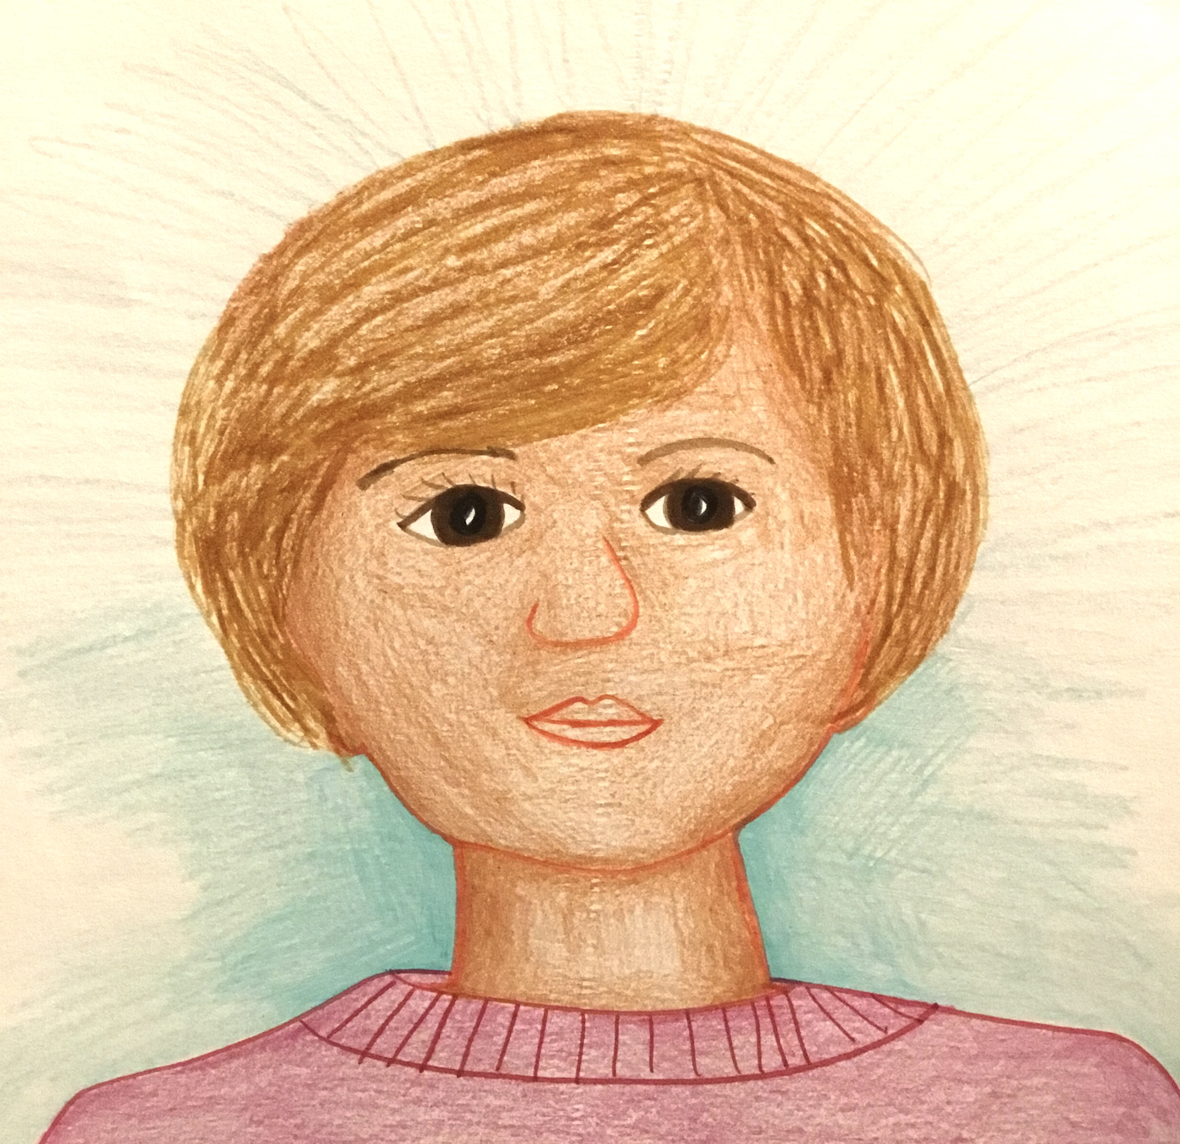
At breakfast I sat as far away from people as I could. My friend Julie noticed and crossed the room to see if I was OK. She cheered me up. I changed my mind about the pills because of her.

Slide 10
I went to science class and got my test back. I got an A+!!! I was happy for a few minutes. Maybe I am not stupid.

Slide 11
It was an ok day at school, but as usual, I still had to take the bus home at the end. I went home on the late bus because I did not want to go home at all.

Slide 12
My problem was ups and downs so bad I wanted to die.
Later I learned I had this problem because I was seeing myself through the eyes of other people, like my mother, my teachers, and my friends. When they were unhappy with me, I would crash.

Slide 13
I was about 22 years old when I read the whole Bible. I read this in Daniel 9:23
“…for you are greatly beloved.”
It was then that I realized that God loves me!!!!! I decided to see myself through God’s eyes instead of anyone else’s eyes. This is the key. This is what healed my sadness and my ups and downs.

Slide 14
So now no matter what life did to me, my view of myself stayed the same. That’s because God loves me with an everlasting love, and He does not change.

Slide 15
That is God’s grace, God’s love, God’s mercy. His love is unconditional. There are no mistakes I can make that would change how He feels about me.

Slide 16
So now life brings me storms and disappointments, but I am able to weather them!
“You can’t be on OUR team!”

Slide 17
I am greatly beloved.
God loves me.
I will be on whatever team the teacher places me.

Slide 18
My boss: “This work is not done right!!!”

Slide 19
I am greatly beloved.
God loves me.
I will correct any mistakes I made,
and do a great job!

Slide 20
Someone is nasty to me……

Slide 21
I am greatly beloved.
God loves me.
I know that I am fearfully and wonderfully made. I can ask God for wisdom and He will help me learn anything I need to know.

Slide 22
People may wonder why I was born. I know. I was born to do God’s work and to glorify Him! He knew me and planned me before I was born!

Slide 23
It doesn’t bother me if people do not understand me. That is their problem. I am greatly beloved by God. I do not need their approval.

Slide 24
Today I am a nurse…

Slide 25
And a teacher of the Bible! I am somebody!

Slide 26
I am saved in Christ!

Slide 27
I have…

Slide 28
I have JOY!!!

