Slide 1
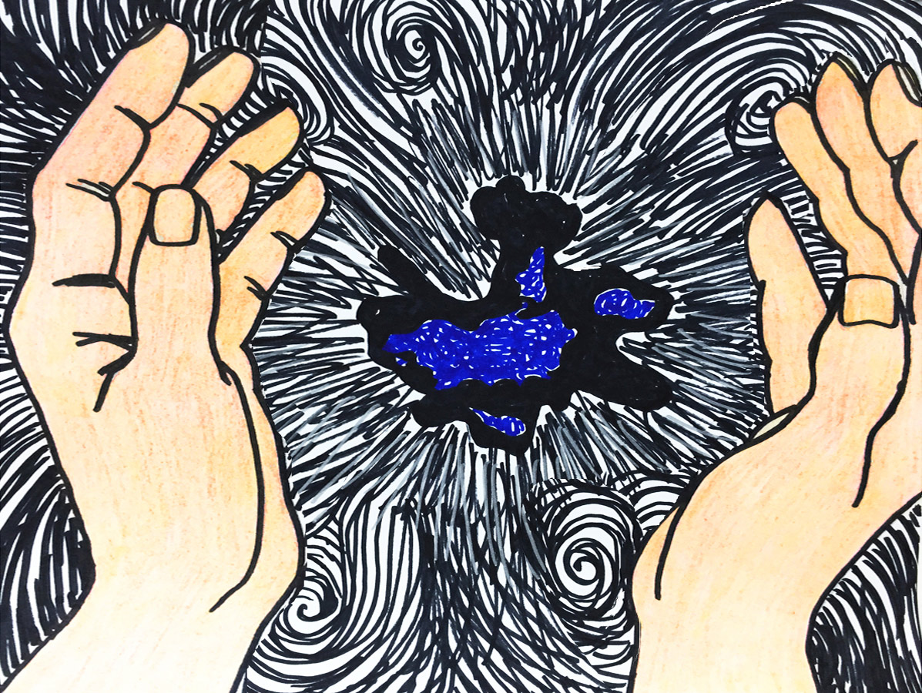
The Bible Story of God’s Creation
Illustrated by Sandra McTiernan, paraphrased from NKJV

Slide 2
God can do anything!

Slide 3
In the beginning, God created the heaven and the Earth. All things were made by God through Jesus Christ. (Hebrews 1:2) This is the story of how it began: The Earth had no shape at first and it was empty. It was dark and deep.
The Holy Spirit moved over the waters.

Slide 4
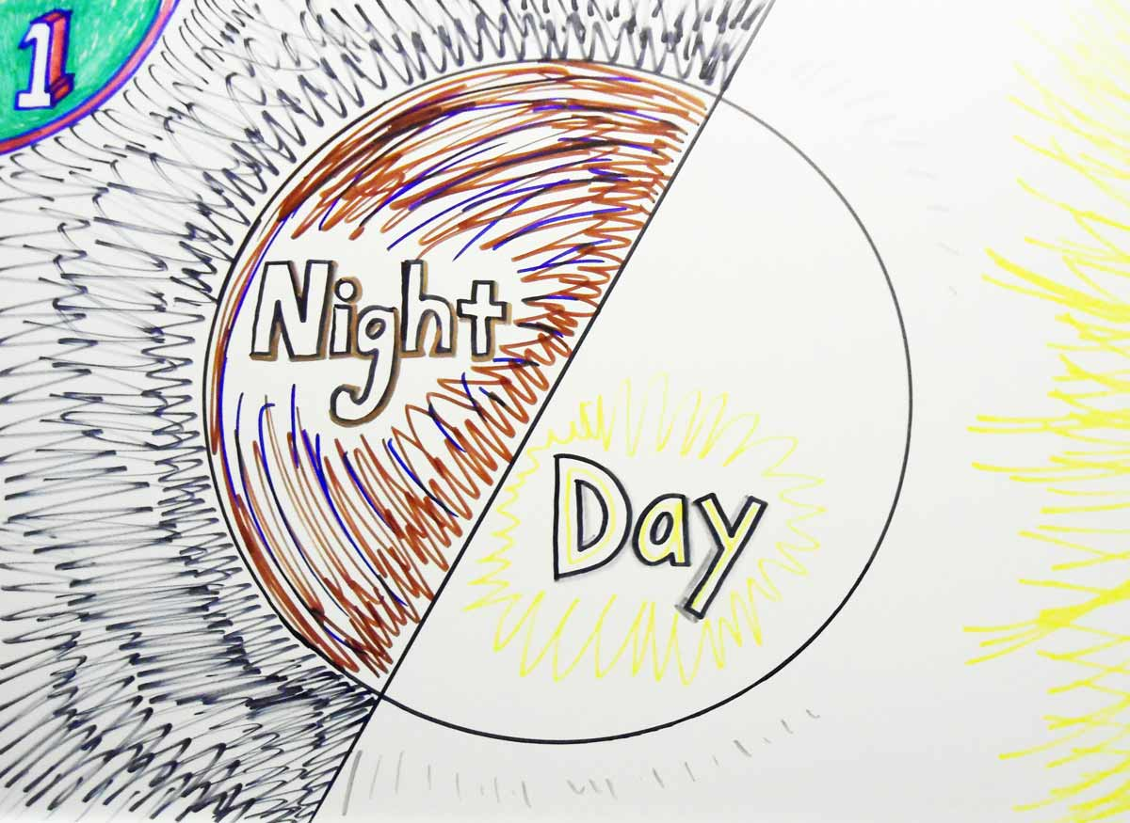
And God said, “Let there be light;” and there was light. God then divided the light from the darkness.
He called the light day, and the darkness he called night. This was the first day of creation.

Slide 5
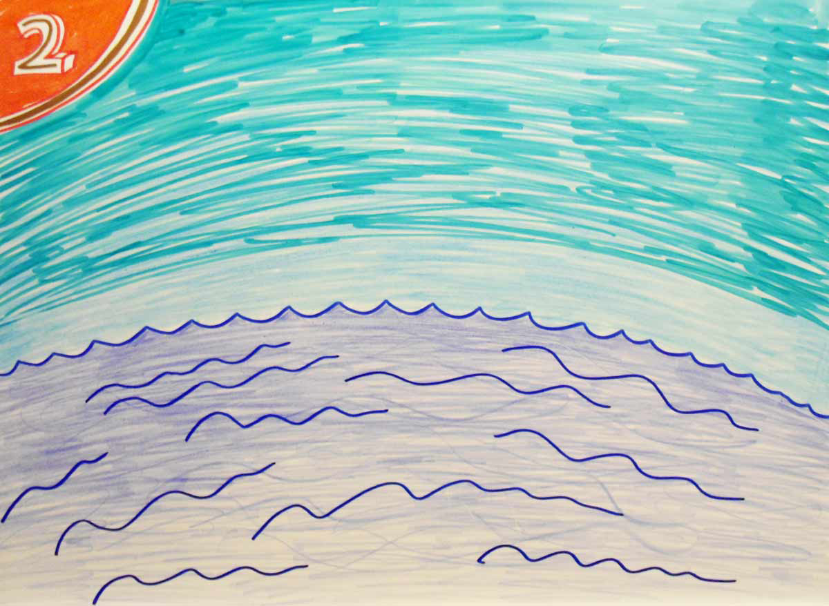
And God said, “Let there be sky.” And it was so.
God separated the sky from the waters. He called the sky heaven. This was the second day.

Slide 6
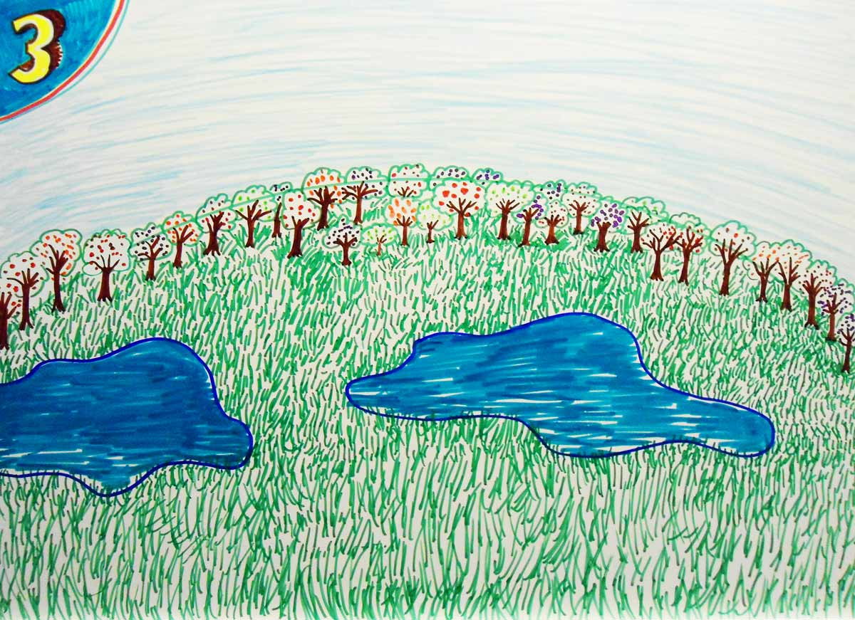
And God said, “Let the waters be gathered together in one place, and let the dry land appear;”
and it was so. He called the dry land earth; and the gathering together of the waters He called seas; and God saw that it was good. And God said, “Let the earth bring forth grass and fruit trees full of fruit;” and it was so. This was the third day.

Slide 7
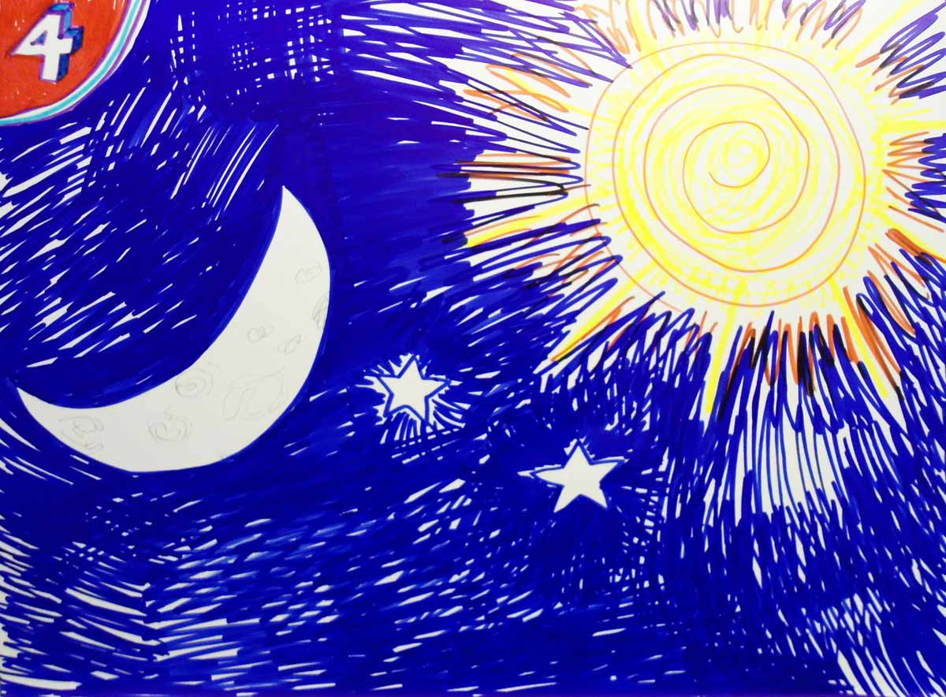
And God said, “Let there be lights in the heaven to separate the day from the night; and let them be for signs of seasons, days, and years. Let them be for light in the sky to shed light on the Earth;” and it was so. And God made two great lights; the greater light to rule the day, and the smaller light to rule the night.
He made the stars also. God set them in the heavens. And God saw that it was good.
This was the fourth day.

Slide 8
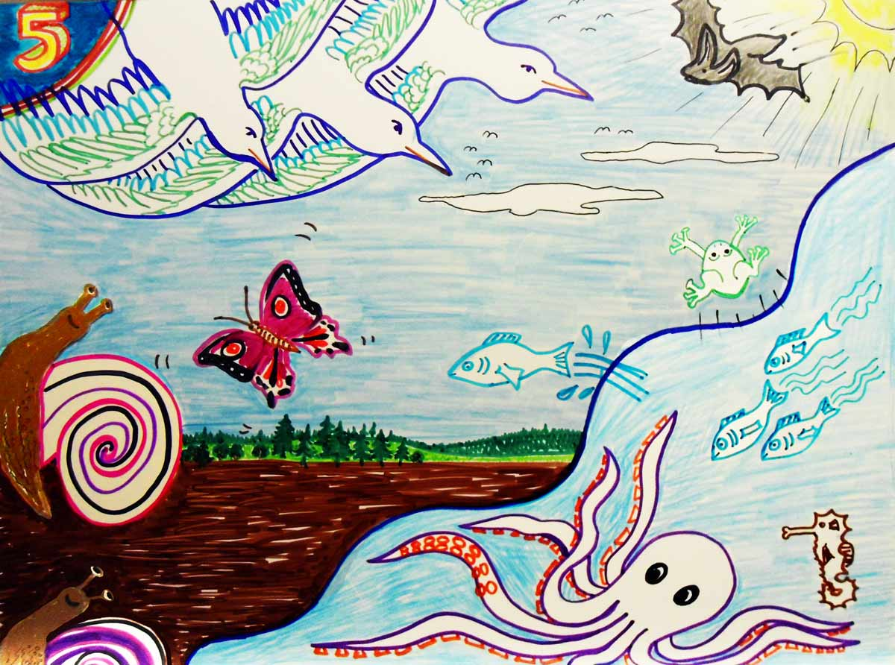
And God said, “Let the waters bring forth all kinds of fish and moving creatures. And let birds fly above the Earth in the open sky.” And God created great whales, and every living creature that moves; and God saw that it was good. Then God blessed them all, saying, “Be fruitful, and multiply.” (Make baby animals, and let them fill the waters and the skies.) This was the fifth day.

Slide 9
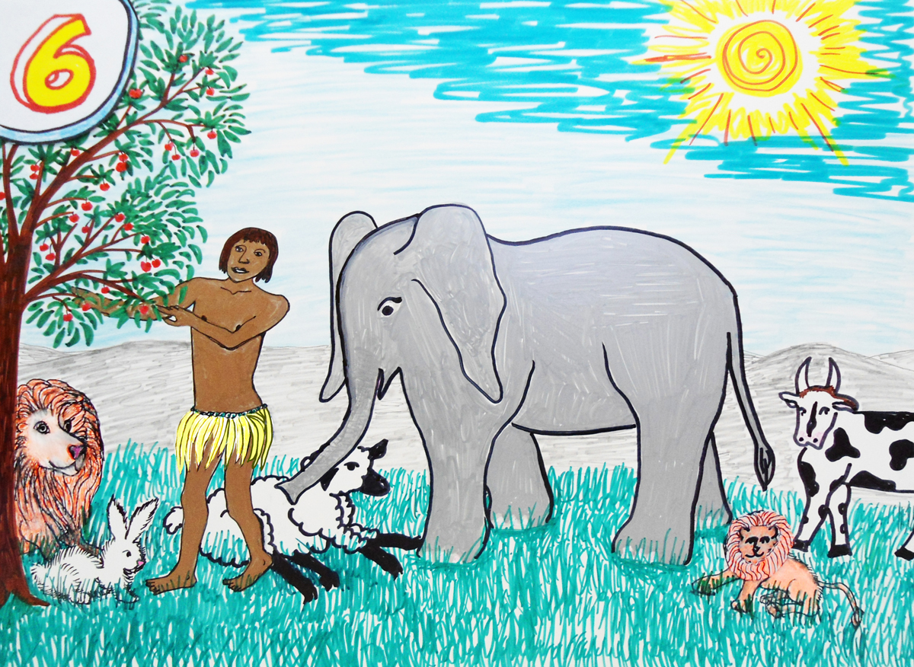
And God said, “Let the earth bring forth cows and creeping things, [and four-legged beasts;]”
and it was so. And God saw that it was good. And God said, “Let Us make man in Our image, after Our likeness.” From the dust of the ground, God created Adam to look like Himself. He put Adam in the Garden of Eden with the plants and animals. God said, “See here, I have given you every plant that makes seed and every fruit for food.”
And God saw everything that He had made; and, behold, it was very good.
And this was the sixth day.

Slide 10
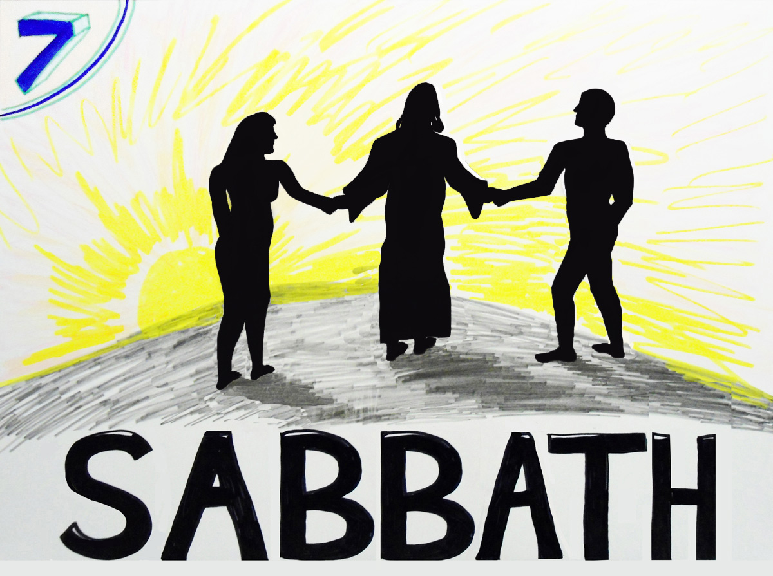
Thus the heavens and the Earth were finished.
And on the seventh day God rested from all His work which He had made.
And God blessed the seventh day, and made it holy. That day is called Sabbath. A short time after the creation week; God created Eve, a woman, from Adam’s rib. After that, Sabbath was a day that Adam and Eve walked hand-in-hand with Jesus in the garden. Today we can spend Sabbath going to church,
studying the Bible, keeping company with other Christians, and being with our families.
We get a special blessing from obeying God’s Sabbath commandment. Amen!

